Slide 1
Designing Data System

Slide 2
Scope of this session
This session will help you navigate the diverse and fast-changing landscape of technologies for processing and storing data.
Relational databases are important but not the final word on dealing with data
New types of database systems (“NoSQL”) have been getting lots of attention, but some of other important things other than database we need to consider are,
message queues
caches
stream processing
batch processing

Slide 3
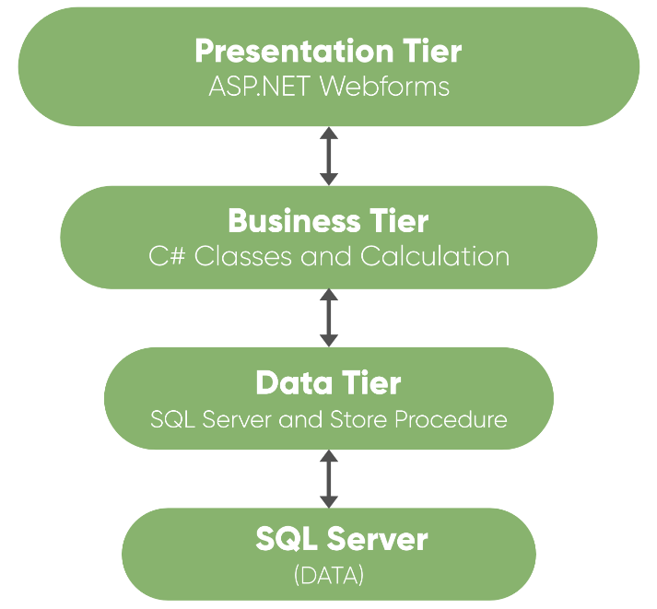
3 Tier Architecture

Slide 4
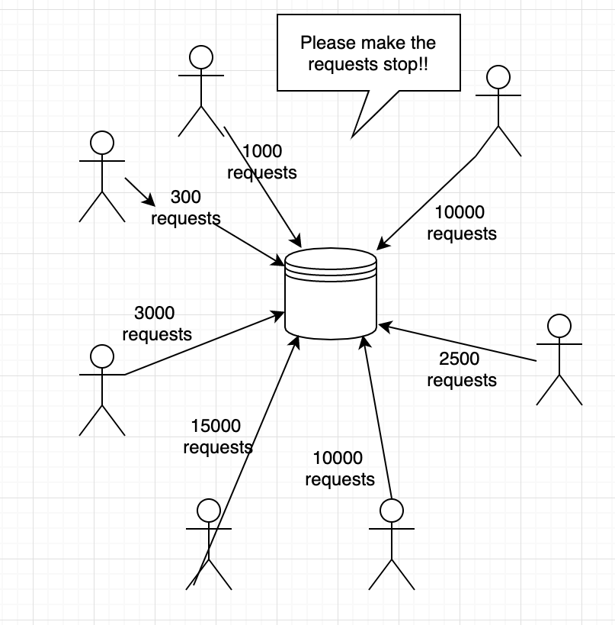
What if we had 1 million users? Does your design still scale?

Slide 5
System Design Topics
Scalability: Every system we use today is built to scale. Scalability is a system’s ability to perform under load. Understand the different approaches to cope with the load — Horizontal Scaling and Vertical Scaling.
Caching: With increasing load, there is an increase in data and fetching from the database every time results in a slow response. Caching improves page load times and can reduce the load on your servers and databases. Read through the caching mechanisms and understand different caching strategies.
Databases: Understand different storages, Relational Databases, and Non-Relational Databases, and SQL vs. NoSQL. For SQL, go through topics like replication, sharding, functional partitioning, denormalization, and ACID properties. For NoSQL, understand topics like BASE properties, different ways NoSQL data is stored — key-value store, document store, wide column store, or a graph database.
Load Balancers: When there is an increasing load, we often use load balancers to distribute the load between the resources such as application servers and databases. Understand the different uses of load balancers and the different load balancing strategies available.
Microservices: Microservice architecture is an application that is deployed as a collection of lightweight and small services. Each service is independent of others and communicates through a well-defined mechanism. While you’re here, read Monolithic vs. Microservice architecture and Service Registry and Discovery.
Other topics worth reading and learning are — CDN, Job Queues, Message Queues, Consistency Patterns, Availability Patterns, CAP theorem, Asynchronous communication mechanisms, long polling, rate limiting, consistent hashing, and Reverse Proxy.

Slide 6
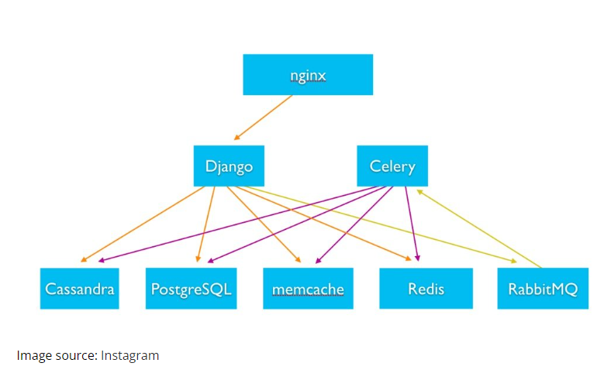
Instagram Architecture

Slide 7
Data Models
Relational Model vs. Document Model
The best-known data model today is probably that of SQL, based on the relational model proposed by ‘Edgar Codd’ in 1970.
Network model, Hierarchical model, Object model – many models were established but Relation model continued its dominance
Now, in the 2010s, NoSQL is the latest attempt to overthrow the relational model’s dominance.
The term NoSQL is unfortunate, since it doesn’t actually refer to any particular technology — it means Not Only SQL.

Slide 8
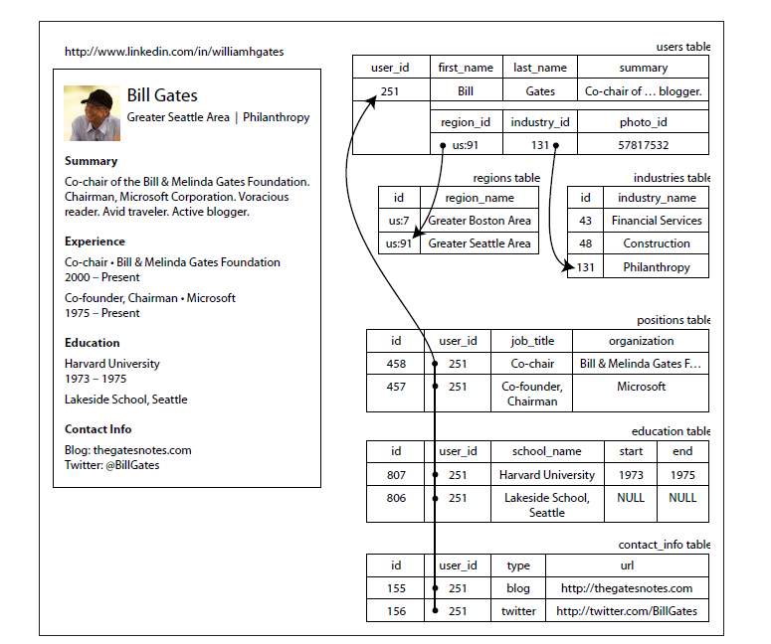
Relational Model of LinkedIn Profile

Slide 9
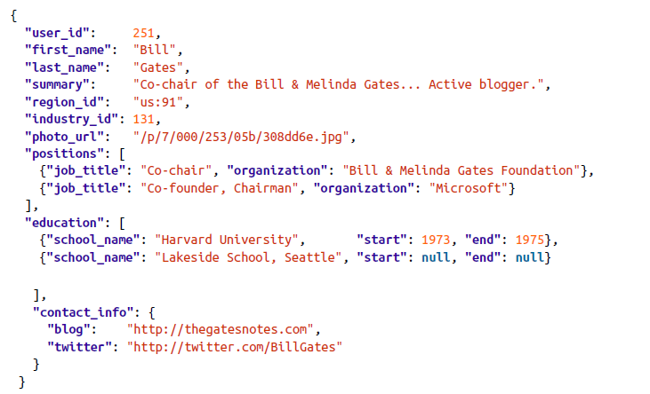
JSON document representation

Slide 10
Convergence of document and relational databases
In previous example, region_id and industry_id are given as IDs, not as plain-text strings "Greater Seattle Area" and "Philanthropy". Why?
Most relational database systems (other than MySQL) have supported XML since the mid-2000s. This includes functions to make local modifications to XML documents, and the ability to index and query inside XML documents, which allows applications to use data models very similar to what they would do when using a document database.
PostgreSQL since version 9.3 and IBM DB2 since version 10.5 also have a similar level of support for JSON documents. Given the popularity of JSON for web APIs, it is likely that other relational databases will follow their footsteps and addJSON support.
On the document database side, RethinkDB and many others started supporting relational-like joins in its query language
It seems that relational and document databases are becoming more similar over time, and that is a good thing: the data models complement each other. If a database is able to handle document-like data and also perform relational queries on it, applications can use the combination of features that best fits their needs.
A hybrid of the relational and document models is a good route for databases to take in future.

Slide 11
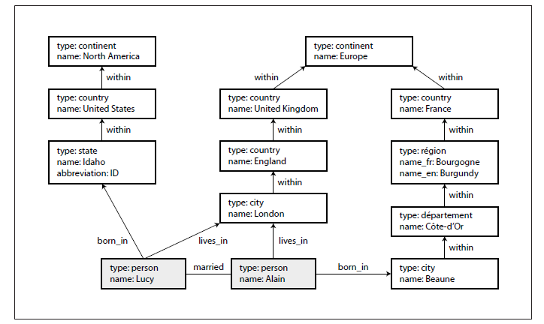
Graph Data Model
What if many-to-many relationships are very common in your data? The relational model can handle simple cases of many-to-many relationships, but as the connections within your data become more complex, it becomes more natural to start modeling your data as a graph.
A graph consists of two kinds of object: vertices (also known as nodes or entities) and edges (also known as relationships or arcs).

Slide 12
Query Languages for Data
Imperative language vs Declarative Query language
An imperative language tells the computer to perform certain operations in a certain order. You can imagine stepping through the code, line by line, evaluating conditions, updating variables, and deciding whether to go around the loop one more time.
function getSharks() {
var sharks = [];
for (var i = 0; i < animals.length; i++) {
if (animals[i].family === "Sharks") {
sharks.push(animals[i]);
} } return sharks; }
When SQL was defined, it followed the Declarative Query language
SELECT * FROM animals WHERE family = 'Sharks';
In a declarative query language, you just specify the pattern of the data you want but not how to achieve that goal. It is up to the database system’s query optimizer to decide which indexes and which join methods to use, and in which order to execute various parts of the query. it also hides implementation details of the database engine, which makes it possible for the database system to introduce performance improvements without requiring any changes to queries.

Slide 13
The Cypher query language - Graph Data Model
MATCH
(person) -[:BORN_IN]-> () -[:WITHIN*0..]-> (us:Location {name:'United States'}),
(person) -[:LIVES_IN]-> () -[:WITHIN*0..]-> (eu:Location {name:'Europe'})
RETURN person.name
The query can be read as follows: “Find any vertex (call it person) that meets both of the following conditions:
1. person has an outgoing BORN_IN edge to some vertex. From that vertex, you can follow a chain of outgoing WITHIN edges until eventually you reach a vertex of type Location, whose name property is equal to “United States”.
2. That same person vertex also has an outgoing LIVES_IN edge. Following that edge, and then a chain of outgoing WITHIN edges, you eventually reach a vertex of type Location, whose name property is equal to “Europe”.

Slide 14
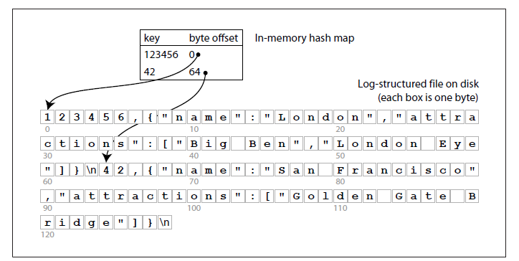
Storage and Retrieval
Hash Indexes
The hash table must fit in memory, so if you have a very large number of keys, you’re out of luck. In principle, you could maintain a hash map on disk, but unfortunately it is difficult to make an on-disk hash map perform well. It requires a lot of random access I/O, it is expensive to grow when it becomes full.
Range queries are not efficient. For example, you cannot easily fetch the values for all keys between kitty00000 and kitty99999 — you’d have to look up each key individually in the hash maps.

Slide 15
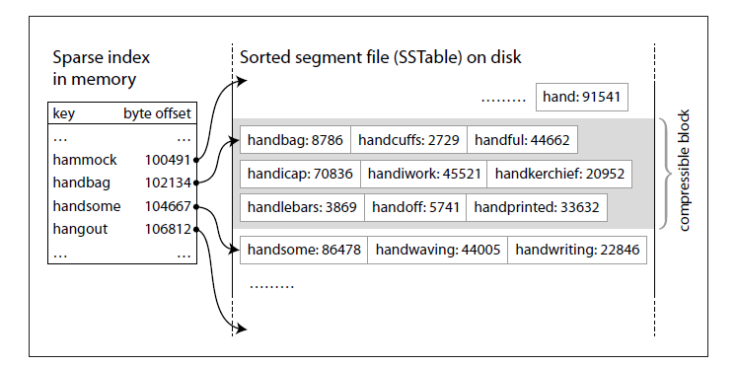
Storage and Retrieval
Sorted string table (SST )/ Log-Structured Merge-Tree (LSM)

Slide 16
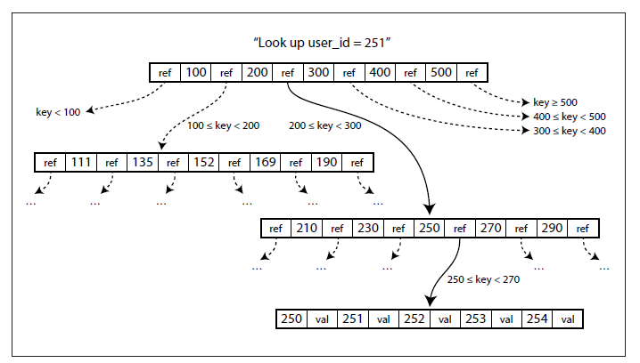
Storage and Retrieval
B-trees

Slide 17
B-trees
It is most commonly used in database and file systems.
B-trees break the database down into fixed-size blocks or pages, traditionally 4 kB in size, and read or write one page at a time. This corresponds more closely to the underlying hardware, as disks are also arranged in fixed size blocks.
Each page can be identified using an address or location, which allows one page to refer to another — similar to a pointer, but on disk instead of in memory. We can use this to construct a tree of pages.
It is O(log(n)) for search. It means that for N data elements, the algorithm would take log2 N steps. If there are eight elements, the algorithm would take three steps, since log2 8 = 3.
B-tree optimizations
We can save space in pages by not storing the entire key, but abbreviating it.
Additional pointers have been added to the tree. For example, each leaf page may have references to its sibling pages to the left and right, which allows scanning keys in order without jumping back to parent pages.
B-tree variants such as fractal trees [22] borrow some log-structured ideas to reduce disk seeks (and they have nothing to do with fractals).

Slide 18
Indexes
A primary key uniquely identifies one row in a relational table, or one document in a document database, or one vertex in a graph database.
It is also very common to have secondary indexes. In relational databases, you can create several secondary indexes on the same table, using the CREATE INDEX command, and they are often crucial for performing joins efficiently.
A secondary index can easily be constructed from a key-value index: the main difference is that keys are not unique, i.e. there might be many rows (documents, vertices) with the same key
The key in an index is the thing that queries search for, but the value could be one of two things: it could be the actual row (document, vertex) in question, or it could be a reference to the row stored elsewhere(heap file). In some situations, the extra hop from the index to the heap file is too much of a performance penalty for reads, so it can be desirable to store the indexed row directly within an index. This is known as a clustered index
A compromise between a clustered index (storing all row data within the index) and a no clustered index (storing only references to the data within the index) is known as a covering index or index with included columns, which stores some of a table’s columns within the index.
If we need to query multiple columns of a table (or multiple fields in a document) simultaneously, we will use Multi-column indexes
Search for similar keys, such as misspelled words we will use fuzzy index. fuzzy search techniques go in the direction of document classification and machine learning

Slide 19
Transaction Processing vs Analytics
Databases also started being increasingly used for data analytics, which has very different access patterns.
Usually an analytic query needs to scan over a huge number of records, and calculates aggregate statistics (such as count, sum or average)rather than returning the raw data to the user.
For example, if your data is a table of sales transactions, then analytic queries might be:
What was the total revenue of each of our stores in January?
How much more Policies than usual did we sell during our latest promotion?
Which brand of baby food is most often purchased together with brand X toys?

Slide 20
OLTP vs OLAP
The basic access pattern for database is similar to processing business transactions. An application typically looks up a small number of records by some key, using an index. Records are inserted or updated based on the user’s input. Because these applications are interactive, the access pattern became known as online transaction processing (OLTP).
These queries are often written by business analysts, and feed into reports that help the management of a company make better decisions (business intelligence). In order to differentiate this pattern of using databases from transaction processing, it has been called online analytic processing (OLAP)

Slide 21
Data warehousing
At first, the same databases were used for both transaction-processing and analytic queries. SQL turned out to be quite flexible in this regard: it works well for OLTP type queries as well as OLAP-type queries.
These OLTP systems are usually expected to be highly available and to process transactions with low latency, since they are often critical to the operation of the business.
Nevertheless, in the late 1980s and early 1990s, there was a trend for companies to stop using their OLTP systems for analytics purposes, and to run the analytics on a separate database instead. This separate database was called a data warehouse.

Slide 22
ETL
A data warehouse, by contrast, is a separate database that analysts can query to their heart’s content, without affecting OLTP operations. The data warehouse contains a read-only copy of the data in all the various OLTP systems in the company.
Data is extracted from OLTP databases (using either a periodic data dump or a continuous stream of updates), transformed into an analysis-friendly schema, cleaned up, and then loaded into the data warehouse. This process of getting data into the warehouse is known as Extract-Transform-Load (ETL),

Slide 23
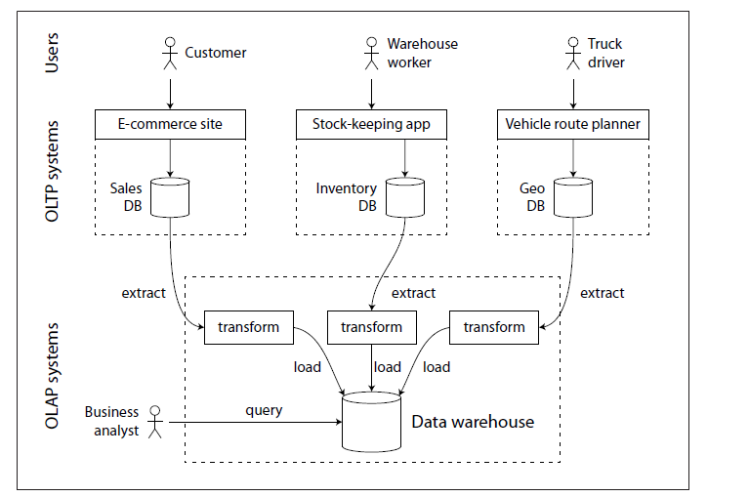
ETL
A big advantage of using a separate data warehouse, rather than querying OLTP systems directly for analytics, is that the data warehouse can be optimized for analytic access patterns.
It turns out that the indexing algorithms discussed before work well for OLTP, but are not very good at answering analytic queries.

Slide 24
Throughput and Latency
In a batch-processing system such as Hadoop, we usually care about throughput the number of records we can process per second, or the total time it takes to run a job on a dataset of a certain size.
In online systems, the response time of a service is usually more important — that is, the time between a client sending a request and receiving a response.
Latency and response time are often used synonymously, but they are not the same.
The response time is what the client sees: besides the actual time to process the request (the service time), it includes network delays and queueing delays. Latency is the duration that a request is waiting to be handled — during which it is latent, awaiting service

Slide 25
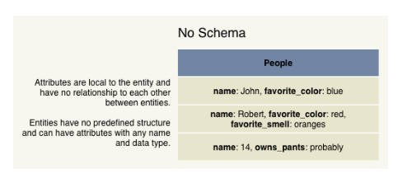
Key-Value Database
Key-value databases, also called key-value stores, are often considered the simplest type of NoSQL databases. Each unique identifier is stored as a key with its associated value.
The value can be any sort of byte array, data structure, or binary large object (BLOB), and works well for storing enormous amounts of data. Windows Explorer and Apple Finder are both key-value databases.
The database is looking for a single key and is returning its associated value rather than attempting to perform complex aggregation
While relational databases are highly-structured repositories of information, non-relational databases do not use a fixed table structure. They are schema-less.
Key value pair (e.g. NoSQL databases) works best when the underlying data is unstructured, unpredictable, or changing often. If you don't have structured data, a relational database is going to be more trouble than its worth because you will need to make lots of schema changes and/or jump through hoops to conform your data to the structure.
If you want O(1) lookups of values based on keys, then you want a KV store. Even with proper indexing, you cannot achieve O(1) lookups in a relational DB
Comparing with RDBMS:
If you want the flexible design of key value pairs, you would be best served by a NoSQL database
Key value pair (e.g. NoSQL databases) works best when the underlying data is unstructured, unpredictable, or changing often. If you don't have structured data, a relational database is going to be more trouble than its worth because you will need to make lots of schema changes and/or jump through hoops to conform your data to the ever-changing structure.
All keys must use VARCHAR for the value; can't store different data types per key.
Good Key-Value Database Use Cases Include:
Session management at high scale
User preference and profile stores
Caching mechanism for frequently accessed data or configuration based on keys.
DISADVANTAGES OF KEY VALUE STORES
No complex query filters
No foreign key constraints
No trigger

Slide 26
Popular key-value databases
DynamoDB. Amazon DynamoDB is a database trusted by many large-scale users and users in general. It is fully managed and reliable, with built-in backup and security options. It is able to endure high loads and handle trillions of requests daily. Provides consistent single-digit millisecond latency.
Aerospike. This is a real-time platform facilitating billions of transactions. It reduces the server footprint by 80% and enables high performance of real-time applications.
Redis. Redis is an open source key-value database. With keys containing lists, hashes, strings and sets, Redis is known as a data structure server.
Riak: It is the database used to develop applications.
Berkeley DB: It is a high-performance and open-source database providing scalability.

Slide 27
Keeping in memory
The data structures discussed so far have all been answers to the limitations of disks. Compared to main memory, disks are awkward to deal with. Both with magnetic disks and SSDs, data on disk needs to be laid out carefully if you want good performance on reads and writes.
However, we tolerate this awkwardness because disks have two significant advantages: they are durable (their contents are not lost if the power is turned off), and they have a lower cost per gigabyte than RAM.
As RAM becomes cheaper, the cost-per-gigabyte argument is eroded. Many datasets are simply not that big, so it’s quite feasible to keep them entirely in memory, potentially distributed across several machines. This has led to the development of inmemory databases.
In-memory key-value stores are intended for caching use only, where it’s acceptable for data to be lost if a machine is restarted
Http Response of web pages, Web API responses, Images, videos, static HTML pages, JavaScript libraries and style sheets are examples of data that are often stored in cache.

Slide 28
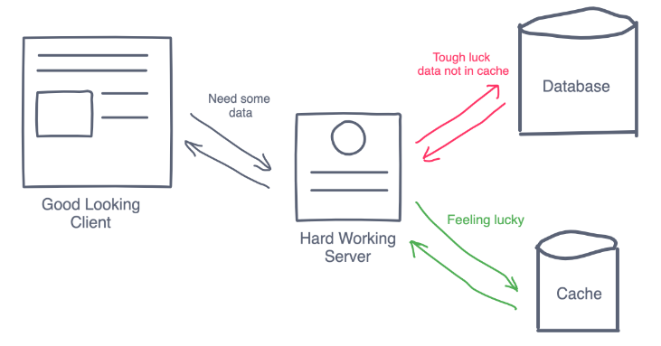
Key-Value Cache
Many key-value databases allow users to store persistent copies of data in hard disks, SSD and other storage devices that can store data permanently. Other key-value databases only store data in memory and are generally known as key-value cache databases.
NoSQL key-value cache databases allow users to retrieved data faster than databases that store data in disks. The cache allows users to quickly access data by reading and storing data in memory to facilitate easy retrieval when needed.
NoSQL key-value cache delivers sub-millisecond response times, enabling millions of requests per second for real-time applications in industries like gaming, ad-tech, financial services, healthcare, and IoT. Some of widely used NoSQL Key-Value data systems are,
Redis (Remote Dictionary Server)
Memcached
Azure cache for Redis
C# implementation examples - Azure cache for Redis
https://www.red-gate.com/simple-talk/development/dotnet-development/overview-of-azure-cache-for-redis/
https://www.c-sharpcorner.com/article/how-to-use-azure-redis-cache-in-c-sharp/

Slide 29
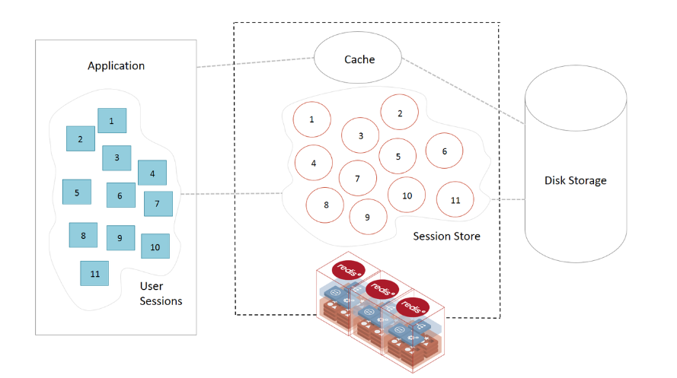
Session vs Cache

Slide 30
Row vs Column Oriented Databases
Row oriented databases are databases that organize data by record, keeping all of the data associated with a record next to each other in memory. Row oriented databases are the traditional way of organizing data and still provide some key benefits for storing data quickly. They are optimized for reading and writing rows efficiently.
Common row oriented databases:
PostgreSQL
MySQL
Column oriented databases are databases that organize data by field, keeping all of the data associated with a field next to each other in memory. Columnar databases have grown in popularity and provide performance advantages to querying data. They are optimized for reading and computing on columns efficiently.
Common column oriented databases:
Redshift
BigQuery
Snowflake

Slide 31
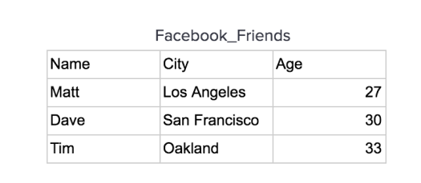
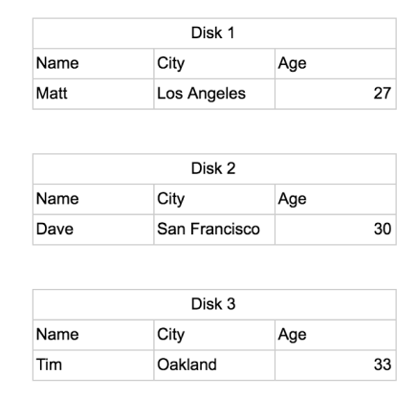
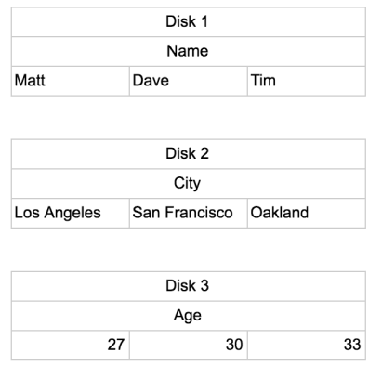
Row vs Column Oriented Databases
Reading from Row Store Databases
Row oriented databases are fast at retrieving a row or a set of rows but when performing an aggregation it brings extra data (columns) into memory which is slower than only selecting the columns that you are performing the aggregation on. In addition the number of disks the row oriented database might need to access is usually larger.
Say we want to get the sum of ages from the Facebook_Friends data. To do this we will need to load all nine of these pieces of data into memory to then pull out the relevant data to do the aggregation.
Let’s assume a Disk can only hold enough bytes of data for three columns to be stored on each disk. In a row oriented database the table above would be stored as:
In a C-Store, columnar, or Column-oriented database, the data is stored such that each row of a column will be next to other rows from that same column.

Slide 32
Wide Column Database

Slide 33
Document Database/Store
Modern applications will probably require more than just a key-value retrieval
Document: an ordered set of keys with associated values
Document Stores are an extension of the simplicity of Key Value stores, where the values are stored in structured documents like XML or JSON. Document stores make it easy to map Objects in the object- oriented software or can get closer to your application data model.
A document database is schema free, you don’t have to define a schema beforehand and adhere to it. It allows us to store complex data in document formats (JSON, XML etc.).
Document databases do not support relations. Each document in the document store is independent and has no referential integrity.
Document stores can be used for all use cases of a KV store database, but it also has additional advantages like there is no limitation of querying just by the key but even querying attributes within a document, also data in each document can be in a different format.
E.g, A product review website where zero or many users can review each product, and each review can be commented on by other users and can be liked or disliked by zero to many users.

Slide 34
